Slide 1
Google Sites
Set your
Debbie Raukar
@raukon
debbie.raukar@raypec.org
debbie.raukar@gmail.com
Raukar Everything Google Site Weebly
raukar.weebly.com/google-sites.html
Google Sites
sites.google.com/a/raypec.org/google-set-your-sites

Slide 2
Why G Sites?

Slide 3
Google Sites
How can you use Google Sites?
1: Simple…Loading Dock of all your work…(don’t link it to weebly,
just have access to it. Label by group
2: Art Gallery to display student work
3: Shared sites for core subjects (i.e. all the 3rd grade math in a building)
4: For presentations within or outside the district that you don’t want to link to main site.
5: Create a site for your classroom.
I already have Weebly…why do I need Google.
Weebly and Google can merge together to suit your particular needs.
Primarily the reason is…
to allow students the opportunity to create web pages for projects,
portfolios of their work, etc. Weebly is +13 and Google sites is not.

Slide 4
Classroom Use
How can you use Google Sites?
1: Simple…Loading Dock of all your work…(don’t link it to weebly, just have access to it.
Label by group
2: Art Gallery to display student work
3: Shared sites for core subjects (i.e. all the 3rd grade math in a building)
4: For presentations within or outside the district that you don’t want to link to main site.
5: Create a site for your classroom.
6: Could be a great way to share assignments with other classes (i.e. DL could help kids set
up the page, classroom teacher follows through.
I already have Weebly…why do I need Google.
Weebly & Google can merge together to suit your particular needs. Primarily
the reason is…
to allow students the opportunity to create web pages for projects, portfolios
of their work, etc.

Slide 5
Google Vocab.
Learn the terms.
Landing Pad: This refers to the home page.
Table: not the one you eat on, the format you use to layout
your web page.
Gear

Slide 6
Class
Ideas

Slide 7
Idea: Hodge Podge
Any
Pick a topic based on something you are currently learning
or have studied this year.
___minimum of 3 links (about your topic)
___minimum of 3 links of video about your topic. (from National
Geographic, Teacher Tube, Youtube, etc.)
___Have a paragraph that explains your topic.
___You need to have a map of where your author lives or location of book.
___You also need photographs of your book and/or author (up to 6).
___You may make a QA about a video.
___Google Classroom Assignments:
Share your site.
Click the address (URL) above-it should highlight in blue. CTRL-C (copy).
Go to G Classroom. Click Assignment. Click ADD LINK. CTRL-V (paste) in box.
Click TURN IN...TURN IN.
B. Send a picture of you with the author or the book.
Example: You share a cake recipe with pictures, links, and videos.
You have participants double or halve or triple recipe ingredients.
Instead of doing it on the page, try creating a Google form with the information.
EXTRA: Create a video of your topic and add to page or put in Youtube account & create a link on your page.

Slide 8
Idea: Measuring and Fractions
MATH
Make a page about measuring and/or fractions for math.
___minimum of 3 links (could be math games, tutorials,
worksheets, etc.)
___minimum of 3 links of videos about your topic-LINKS i.e.
National Geographic, Teacher Tube, Youtube, etc.)
___A paragraph or presentation that explains the concept.
___You also need photographs related to your topic (minimum
of 3.
___You may make a QA about your math topic (could be in
Google form).
___Google Classroom Assignments: turn in your link to your
web page.
Share your site.
Click the address (URL) above-it should highlight in blue.
CTRL-C (copy).
Go to G Classroom. Click Assignment. Click ADD LINK.
CTRL-V (paste) in box.
Click TURN IN...TURN IN.
Bonus: Create a poster that explains the concept. Turn it
into a .png or .jpg & add it to your website page.
Sample template to get started.

Slide 9
IDEAS Favorite Book or author
ELA
GOOGLE SITE ASSIGNMENT: For this activity, you will create a site page about your
favorite and/or famous author and/or book. ___minimum of 3 links (link URL to title-information about the author, book, plot, summary, etc. ___minimum of 3 links of videos (how to become a writer, about the book, author, etc.) ___Write a paragraph about author or book. (i.e. reviews book, summary of book, author bio)
___Create a map of where your author lives or location of book. ___BONUS: Create a travel map of the setting of the story.
___You also need photographs of your book title (could be a picture of you holding the book
or holding a photo of you with author or superimpose-(advanced) your pic with theirs ___You may make a QA about a video or your book (could be in Google form).For this site,
you need to send me a picture of where you went and a short historical description. ___OPTIONAL Create a class survey of their favorite authors. Graph it.
You may share your document with one other person and give them editing rights if
you wish to partner together. Be sure if you are given the editing rights you collaborate
with the owner of site to make sure everything is OK. Always keep it school appropriate.
OPTIONAL: Timeline of events, Facts list, journal of your thoughts as you read book.
(Kids Blog-if you have a login).
Try and arrange a Google Hangout with author and request it be done in class.
If you do it at home, make sure you do it with parent knowledge and approval.

Slide 10
IDEAS Travel route of history
Social Studies
GOOGLE SITE ASSIGNMENT: For this activity, you will select a significant time period
of US history. Travel Historical United States or this activity, you will select a significant
time period of US history. (i.e. Civil War, Lewis and Clark, Oregon Trails,(i.e. Civil War,
Lewis and Clark, Oregon Trails, Revolutionary War, etc.) You are going to travel to a location of your choice related to your historical topic. ___minimum of 3 links (could include restaurants, places to stay, gas mileage, expenses,
etc.) ___minimum of 3 links of videos of location (i.e. National Geographic, Teacher Tube,
Youtube, etc.) ___Have a paragraph that lists the historical significance of your visit. ___You need to have a travel map with road directions. (include museums, sites,
reenactments, etc.) ___You also need photographs of your trip (minimum of 6) that tell your story. ___You may make a QA about a video or your trip (could be in Google form).For this site,
you need to send me a picture of where you went and a short historical description.
You may share your document with one other person and give them editing rights if
you wish to partner together. Be sure if you are given the editing rights you collaborate
with the owner of site to make sure everything is OK. Always keep it school appropriate.
Be sure to cite your sources. . Send a picture(s) of your historical travels (from site-credit your
source...title of site and URL) include a short comment about picture and its history. Kind of like a letter home.
If you want to bump it up to the next level. Superimpose your image on the photo
(using green screen or digital artistry).

Slide 11
IDEAS
ANY
DID YOU EVER WONDER…
Real World Math
Measurements
Example for Real World Math…
Find your favorite recipe and post
it on the web page. At the end of
the recipe, explain how you can
halve, triple, double a recipe.
Add a Google form that asks
questions (share with students).
i.e. If you tripled the recipe,
how much more sugar would you need?
If you tripled the recipe, what would the
TOTAL amount of sugar be? Etc.
ADD tutorial links, videos.
ADVANCED: consider videotaping
at home how to triple, double, etc.
HOW TO…
Directions

Slide 12
IDEAS Ancient Civilizations
Social Studies 6th
GOOGLE SITE ASSIGNMENT: For this activity, select an ancient civilization you are
currently studying or have studied this year. NOTE: You may present it from a variety of viewpoints Including artisans selling their wares in the modern world based on old world culture (jewelry, pottery, housing-could be a real estate agent selling a house from that
time period, museum, etc.) Use your imagination, the options are endless.
___minimum of 3 links (related to the topic.) ___minimum of 3 links of videos (i.e. National Geographic, Teacher Tube, Youtube, etc.) ___Have a paragraph that lists the historical significance of your visit. ___You need to have a map(s) use Google maps to show location. ___You also need photographs in a table format that shows artifacts or items. ___You may make a QA about a video or your trip (could be in Google form). Share it with
your class.
You may share your document with one other person and give them editing rights if
you wish to partner together. Be sure if you are given the editing rights you collaborate
with the owner of site to make sure everything is OK. Always keep it school appropriate.
Be sure to cite your sources. . Send a picture(s) of your historical travels (from site-credit your
source...title of site and URL) include a short comment about picture and its history. Kind of like a
letter home. Create a video about the time period (could be a rap, a song, etc.)
If you want to bump it up to the next level. Superimpose your image on the photo
(using green screen or digital artistry).

Slide 13
IDEAS Civil War Job
Social Studies
GOOGLE SITE ASSIGNMENT: Lesson 4: 3/1 and 3/2: Begin laying out your
Civil War job (or Revolutionary War)
Be sure to add a minimum of 3 links, a minimum of 3 video links
(Youtube, National Geographic, Teacher Tube, etc.).
Write the title and description of the title you elected to use.
You can write your story in first person. Include photos of your occupation as well.. ___minimum of 3 links (could include job description, clothing, lifestyle, etc.) ___minimum of 3 links of videos of location (i.e. National Geographic,
Teacher Tube, Youtube, etc.) ___Have a paragraph that lists the historical significance of your visit. ___Set up a table with a minimum of SIX photos about that job you chose. ___You may make a QA about a video or your trip (could be in Google form).
ADVANCED activity (optional): superimpose your face (or body) in the picture.
Tell you story in first person using I, me, you, us, we, etc.
You may share your document with one other person and give them editing rights if
you wish to partner together. Be sure if you are given the editing rights you collaborate
with the owner of site to make sure everything is OK. Always keep it school appropriate.
Be sure to cite your source. OPTIONAL: Timeline of events, Facts list, journal of your life(Kids Blog-if you have a login).

Slide 14
Idea 2a: CW Job Links
Acclaimed Historian Portrays Civil War Balloonist
A Lady’s Toilet 1860s Youtube 2:27
History of Civil War Ballooning
Women and the Civil War Teaching with the Primary Sources
African Americans in the Civil War
New Georgia Encyclopedia Women in the Civil War
American Civil War Complete History 51:50 Youtube
Civil War Fashion 3:07
Authentic Civil War Hairstyle-Women
1860s Fashion Show 6:17
Getting Dressed in 1860s 7:21
Civil War Clothing Workshop 34:11
Civil War Uniform 13:49
Civil War Caps 8:54
Occupational Daguerreotype Portraits From the 1840's and 1850's: Part 3 40 seconds
Images for occupations in 1860s
Civil War Occupations Links
Library MTS Occupation in Civil War
National Park Service
Top 10 Civil War Jobs
Occupations of 1860s
History Channel Women in the Civil War
Teach Us History Women working in Civil War
National Park Service Industry & Economy during Civil War
Schmoop: Society in the Civil War
Children in the Civil War
Children on the Home Front
Ducksters: Daily Life for Kids during the Civil War
Union Army Balloon Corps
Civil War Ballooning
About Education: Balloon Pioneer Thaddeus Lowe
Civil War Balloon Air Force
The Drones of the Civil War
Role of Women in Civil War Youtube 8:26

Slide 15
EG Examples
B10
Six Kingdoms
Six Kingdoms 2
Animal Kingdoms 3
Animal Kingdom 4
Animal Kingdom 5
Animal Kingdom 6
Animal Kingdom 7
Animal Kingdom 8
Calendar link
*DL Artwork & Portfolio
Portfolio of artwork in DL
Portfolio of DL artwork 2
Portfolio of DL artwork 3
B3
S10
Major Leagues
Favorite Author
Favorite Author Rowling
Favorite Author 2
Favorite Author Rowling 2
Favorite Author 3
Favorite Author 4
B8
Coding
Coding 2
Greek Gods and their History
S8
Civil War Occupation
Civil War 2
S9
How to Baking
S6
Dog’s Life
B6
Metric System
https://sites.google.com/a/raypec.org/b10-br-jameson/enbactria

Slide 16
Examples

Slide 17
Examples
PORTFOLIO PAGE: Edina Schools
Biology Page Raukar
Family Vacation (this site could
easily be adapted for school/personal use.
Mrs. Baker’s Google Site (uses the
academic template)
Includes links to tutorials to help
you make changes easily.

Slide 18
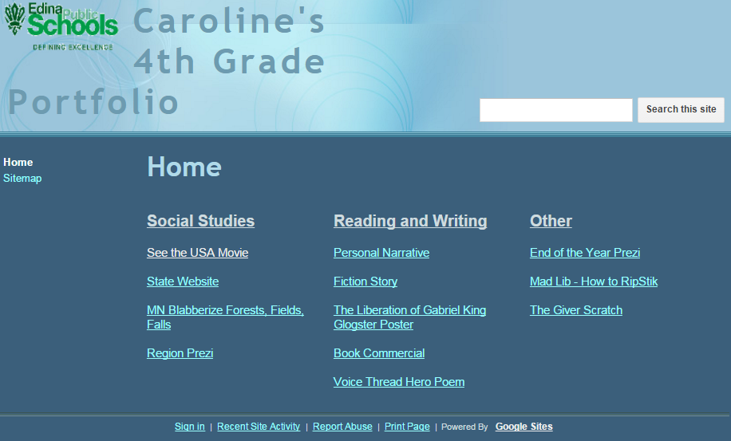
Examples
PORTFOLIO PAGE: Edina Schools
https://sites.google.com/a/pgcps.org/ms-barker-s-google-site/word-of-the-week

Slide 19
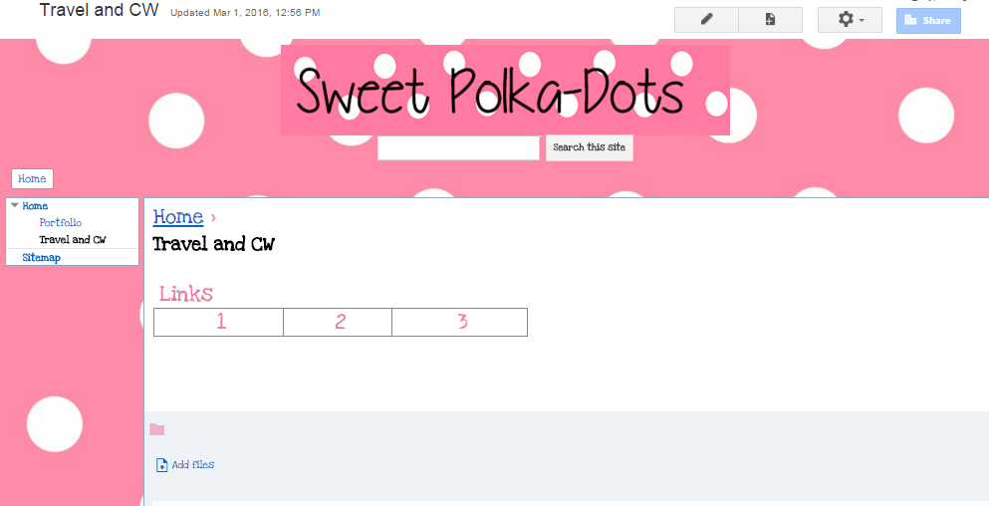
Template
Ideas for template
You can create the template
so students fill in the information.
Instead of typing the title of the
Link…you could include 1…2…3
That way the student highlights
the number and replaces it with
site title or information you wish
to see.
Mode of Transportation during Civil War
1
2
3

Slide 20
Manage
Tips

Slide 21
Management Tips
Beginning project…start with a SHARED class template.
Kids to know…
SHARING RULES: share with TRUSTED friend; friend should never save
Changes unless there is consent by owner. Delete rights of that friend
as soon as project is finished.
Encourage shoulder partners to check up on each other.
GUIDELINES for web page development: Topics should always be
appropriate for school use, age appropriate, etc.
Google sites for Ray-Pec are only viewed by those at raypec.org. Consider
Additional privacy features if the situation is warranted.
Give them guidance regarding naming of their site.
It is better to have them pick a BLANK PAGE and build from there OR
a template you have previously selected or created yourself.
While this could be a great place for journaling. Set guidelines for privacy
for those Under 13- (i.e. no last name, just last name initial, etc.)

Slide 22
Management Tips
PREMADE TEMPLATES CAN CAUSE SECURITY ISSUES
KNOW THIS…some pages have these great links to
WIX website templates that may be used in Google sites.
They are great for teachers
Not for students under 13 because they require their email address to log in to it.
That violates the COPPA privacy policy for 13 and under.
Make sure you make students aware of this feature.
OPTION 1: pick a different template.
OPTION 2: Delete that section.
ITEM 2: Consider how you want to set up access for
Student pages. GEAR…Manage Site…Sharing & Permissions.

Slide 23
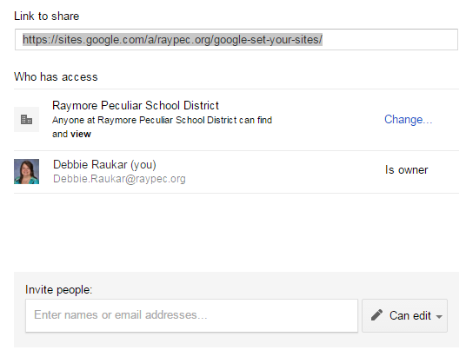
Management Tips
PREMADE TEMPLATES CAN CAUSE SECURITY ISSUES
To get to the privacy areas, you go to Manage Site.
Click GEAR…scroll down to MANAGE SITE…
Sharing and Permissions.
Click SHARE to see which setting works
best for your students.

Slide 24
Privacy & Accuracy Issues
Be sure to review privacy issues with students regarding Google Sites.
This is a school issued option and school rules follow.
Things to consider…(whoever sees your page needs to see your best foot forward.)
___spelling ____grammar ___workable links ____good graphic design
___good color ____great links ___a hook-to grab peoples’ attention
It is better to have a site with 3 pages that has been proofread, has working links, etc.
than it is to make 20 pages full of under construction, errors, etc. Keep those extra pages
On your wish list and add as time permits proofreading and testing links
as you go. It is always a good idea to have someone else proofread your site.
Keep your work anonymous. Use first name and last name initial
(or first 2 initials).
Don’t reveal personally identifiable information.
This school site should only show for people who have access to raypec.org.

Slide 25
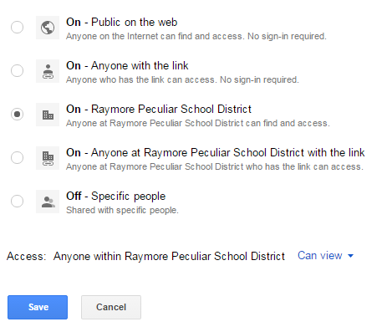
Privacy & Accuracy Issues p. 3
Keep your work anonymous. Use first name and last name initial (or first 2 initials).
Don’t reveal personally identifiable information.
This school site should only show for people who have access to raypec.org.
NOTE: students do not have the public on web option

Slide 26
Management Tips
PREMADE TEMPLATES CAN CAUSE SECURITY ISSUES
ITEM 2: Consider how you want to set up access for
Student pages. GEAR…Manage Site…
Sharing & Permissions.
The box you see below appears at the top right
corner of Sharing & Permissions.
This is a great option to sharing an entire site
with students. This would allow you to create a site
devoted to one project and each student(s) has access to one page.
https://support.google.com/sites/answer/
1387384?ref_topic=1387383&rd=1

Slide 27
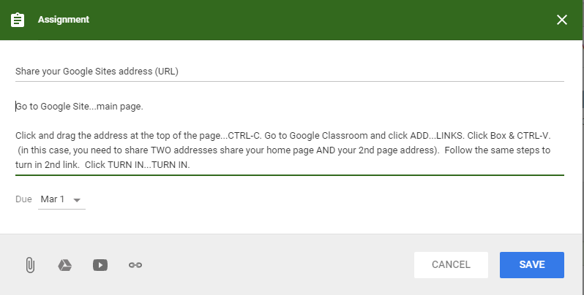
SHARE THEIR LINK in Google Classroom
NOTE: If you want them to share their site
with the whole class, have them paste their
site address into the comment section too.

Slide 28
Set the
Table

Slide 29
Table Tips
NOTE: If you don’t see the pencil, be sure to
click SAVE (if the blue SAVE box appears).
Click the Pencil to edit your page. Click where the table should appear.
Click cell in table & drag to resize.
Do to each table.
To add a picture, text, etc. to a cell,
Click it.
Color in the
boxes to make
your table size.
You can edit your
table by using choices
on right.

Slide 30
Table Tips 2
Make an invisible/NO border
Edit Table or have SOME borders.
1
Step 1: Click where you want table to start. Make your table.
Step 2: Click HTML. See the HTML code for table.
Example:
<table border="1" bordercolor="#888" cellspacing="0" style
="border-collapse:collapse;border-color:rgb
(136,136,136);border-width:1px“ > Delete part in red. <border>
This is great if you want have a more professional layout. Click SAVE.
2
3
TABLE TAG INFO
<table>: starts table.
<tr> : table row-how table is divided.
<td> : delineates table data
<th> : table headings
<caption>: table caption
Attribute: border (tells you style & #)
CSS Border: (different measure)
table, th, td { border: 1px solid black; }

Slide 31
Prepare & Plan
Preparation and planning is the key for a great web site.
Students and/or teachers
Make a list of 10 things you believe you should have on your website.
Look at other websites similar to the one you want to make for ideas.
Decide if you can fit those 10 things on 3 pages.
Anything left over on the list goes to your WISH list. This list
will help you make your next plan. You should focus on launching
Your site.

Slide 32
What you need
Gmail account-not required, but easier
A plan…how do you plan to use it?
What supplies do you need to collect or make?
It is really smart to create a G sites folder
for EACH web site you develop.
That way you can quickly load everything.
Once you’ve loaded the images, files,
you can move those to a sub folder marked
loaded).

Slide 33
Helpful Sites
Google Apps Learning Center Everything Google Sites Videos & more
Google Sites Learning Center Domain Names options
JS Google Sites Help
HTML W3 Schools (Advanced)
Raukar Google Sites
Customize Site Logo
How to replace pictures with your own
Replace a calendar Copy Google site to different account
Delete a post
Great Templates from Google Sites
Free Templates for Google through Wix-+13
Change Site logo
Edit Site Layout & Customization 13:57
Change Google Sites Background Image video
Create a Google Site 2015 video 14:50
Change background image 2 video 6:48
Color Palette ideas for site Google Sites Layout 12:06
BONUS Teacher Tech Getting Started with Google Sites 32:54
https://sites.google.com/site/sitetemplateinfo/home
Notes:
Google Apps Learning Center https://apps.google.com/learning-center/
Google Sites Learning Center https://apps.google.com/learning-center/products/sites/#/list
http://www.w3schools.com/html/default.asp

Slide 34
FEATURES:
Why Google Sites?
Examples
Templates
DISTRICT SCHOOL GOOGLE SITES
https://sites.google.com/site/appsforeducationresources/teacher-school-google-sites
Education Google Site Template
http://www.juliesharma.com/teaching/educationgooglesitetemplate
Helpful ways to make a good classroom page
https://www.edsurge.com/news/2015-07-08-how-to-expertly-organize-your-classroom-with-google-sites
Sample 1 https://sites.google.com/site/kstfsampleone/
Sample 2 https://sites.google.com/site/kstfsampletwo/
Sample 3 https://sites.google.com/site/kstfsamplethree/
Follow Molly https://sites.google.com/site/mydigitalfootprint//google-sites-template
** http://www.slideshare.net/MarlenaHebern/easy-google-sites-tips-and-tricks

Slide 35
Google Sites
Set your
Debbie Raukar
@raukon
debbie.raukar@raypec.org
debbieraukar@yahoo.com
Raukar.weebly.com

Slide 36
1
Plan It
Purpose of Site?
Educational, Promotional,
Professional? Audience?
Consider…
GLEs, FAQs,
Expectations
pictures, videos
what you want
Maintenance plan
QR codes, widgets…
__ Decide theme
__ Decide colors
__ Collect images
__ site name (a-z, A-Z, 0-9)
__ Brainstorm
__ Three Pages to start
__ Dream Pages (future)
__ Collect links
__ Make a folder GSites
__ Sub folder…DOWNLOADED
__ Blog pages? Calendar? Art Gallery? File Cabinet?

Slide 37
1
Folder
Open folder
DOWNLOADED
GOOGLE SITES
It is a really good idea to create a folder to store all your pictures,
Files, links, etc. for Google Sites.

Slide 38
Plan It-Page Types
1a
Web Pages
Announcements
Attach documents, format,
Traditional layout
Like a blog, posts chronologically
Traditional or meeting notes,
schedule, etc.
File Cabinet
List Page
Special page devoted to storing
your documents, files, etc.
Create lists of info sorted by column
Start Page
Custom page with personalized gadgets
Landing Page (another name for Home Page)

Slide 39
Plan how to Use it
1b
Blog/Journal
Professional
Create a page for a presentation
Tutorial
Created to teach several items could
attach videos through YouTube, etc.
Classroom
Art Gallery
Flipped Classroom
Videos with direct
link to Youtube.
Portfolio
Maps
Newsletter
Link to Weebly

Slide 40
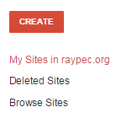
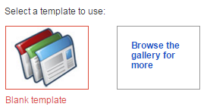
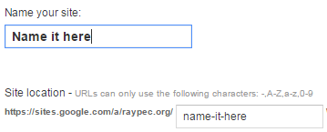
2
Make It
1st Create
GMAIL…APPS
NOTE:
If it is a student site, have them
submit their URL
to Google classroom. Have them SHARE
editing rights.
OPTION 2
OPTION 1
OPTION 3
Short & Sweet is really neat!
If you want more control,
Start with a blank template.
2nd choice-Select a theme
3rd choice-Gallery-restrictive
2nd Create & Wait

Slide 41
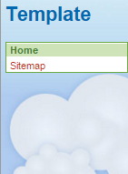
3
Tweak it!
Reset template
Or tweak it
Templates
http://sites.google.com/site/sitetemplateinfo/home
Template Tips
https://sites.google.com/site/sitetemplateinfo/tips
Adding Templates
https://support.google.com/sites/answer/166291?hl=en

Slide 42
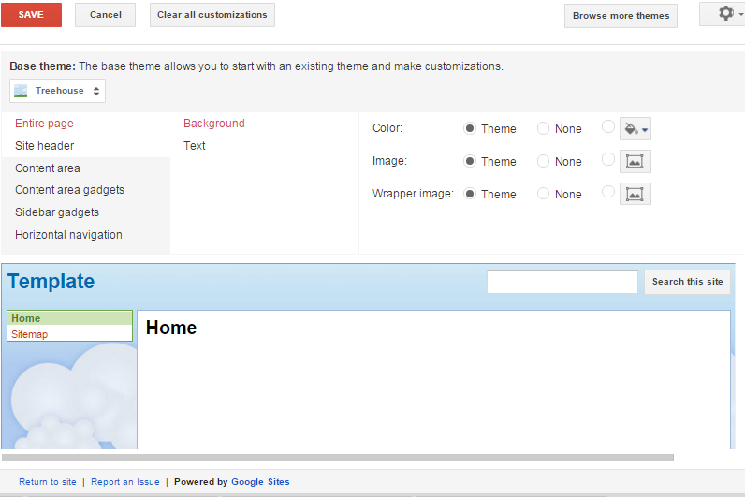
Tweak it!
3b
Reset template
Or tweak it
Change Big Themes
Change your theme here
Change background color
Wrapper image tutorial YOUTUBE 1 minute

Slide 43
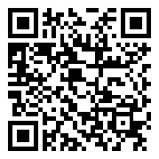
Shadow Puppet EDU
This incredible FREE Apple app
Despite the name it is a powerful presentation
tool for all ages. Easy production.

Slide 44
Shadow Puppet EDU Review
How can you share presentation?
Seesaw Copy Link
iCloud Facebook
Twitter Instagram
YouTube Whatsapp
Email Email puppet file
Message OPEN in video apps
Features: Access photos from your camera (or IPAD),
Add a 30 second video clip (lets you clip it on app.
LINKS FOR Map Search, Famous Landmarks,
Library of Congress, Met Museum of Art, The British Library,
NASA, NOAA, Flickr Creative Commons, Wikimedia Commons,
Backgrounds, Panoramas, Camera Roll, Bursts, Time-lapse,
Videos.
You can use music from Itunes or their library (free too)

Slide 45
BLOXELS
vimeo.com/119405838
www.bloxelsbuilder.com

Slide 46
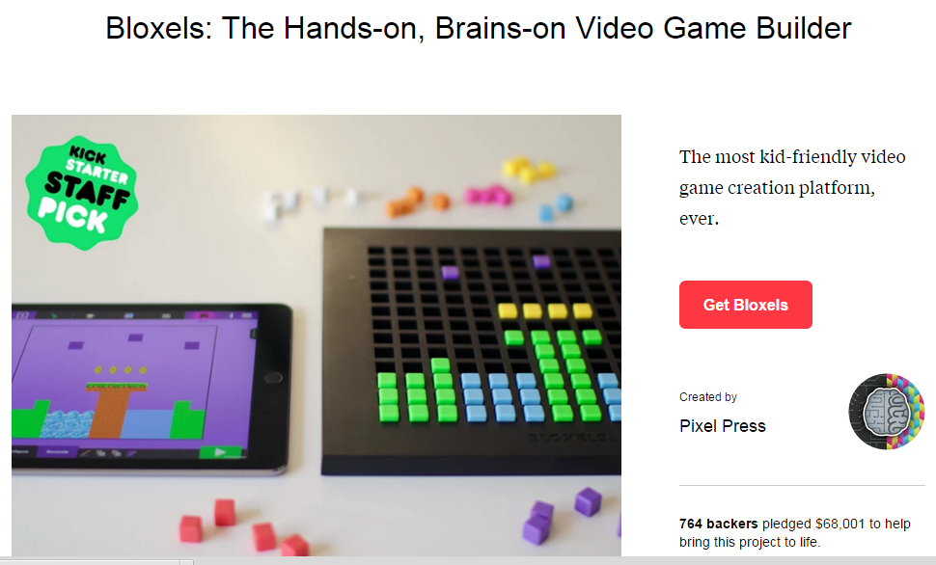
BLOXELS 2
This was a kick start group.
These guys are based out of
The St. Louis area and there
Are seven of them with
This great dream.

Slide 47
What you need
Gmail account-not required, but easier
A place to store your pictures, sites, videos in one place
to make it easy to load your pictures.
To NOT worry that you’re not an expert…you can
learn with the students…learning as you go by trial
and error can be the best teacher and a great motivator

Slide 48
BLOXELS
Shadow Puppet EDU

Slide 50
APPS
GREAT

Slide 51
Shadow
Puppets
EDU
Debbie
Raukar

