Slide 1
Google Maps 1
I can create directions from my house to school AND observe Street view and image of my home

Slide 2
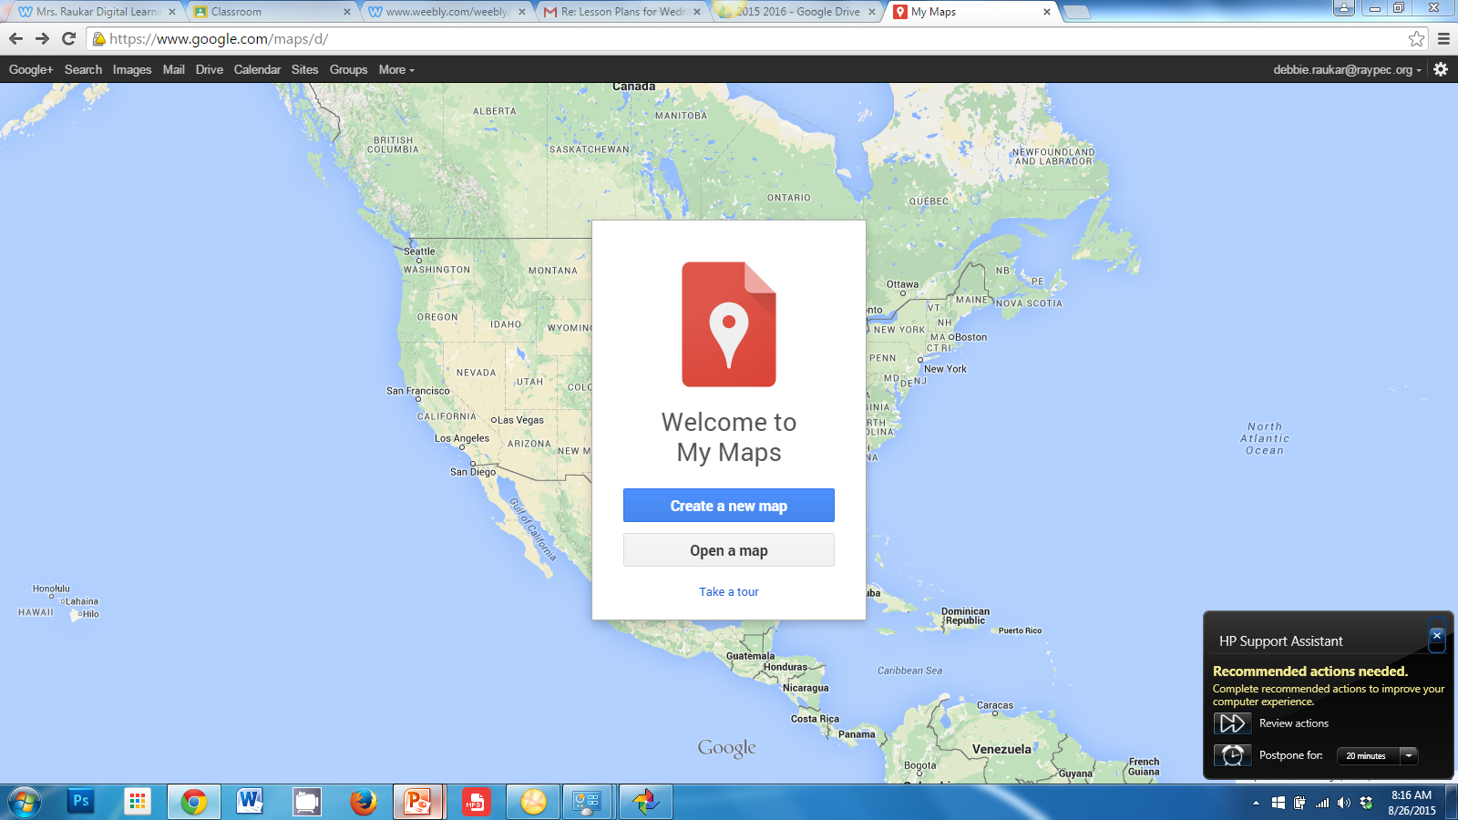

Slide 3
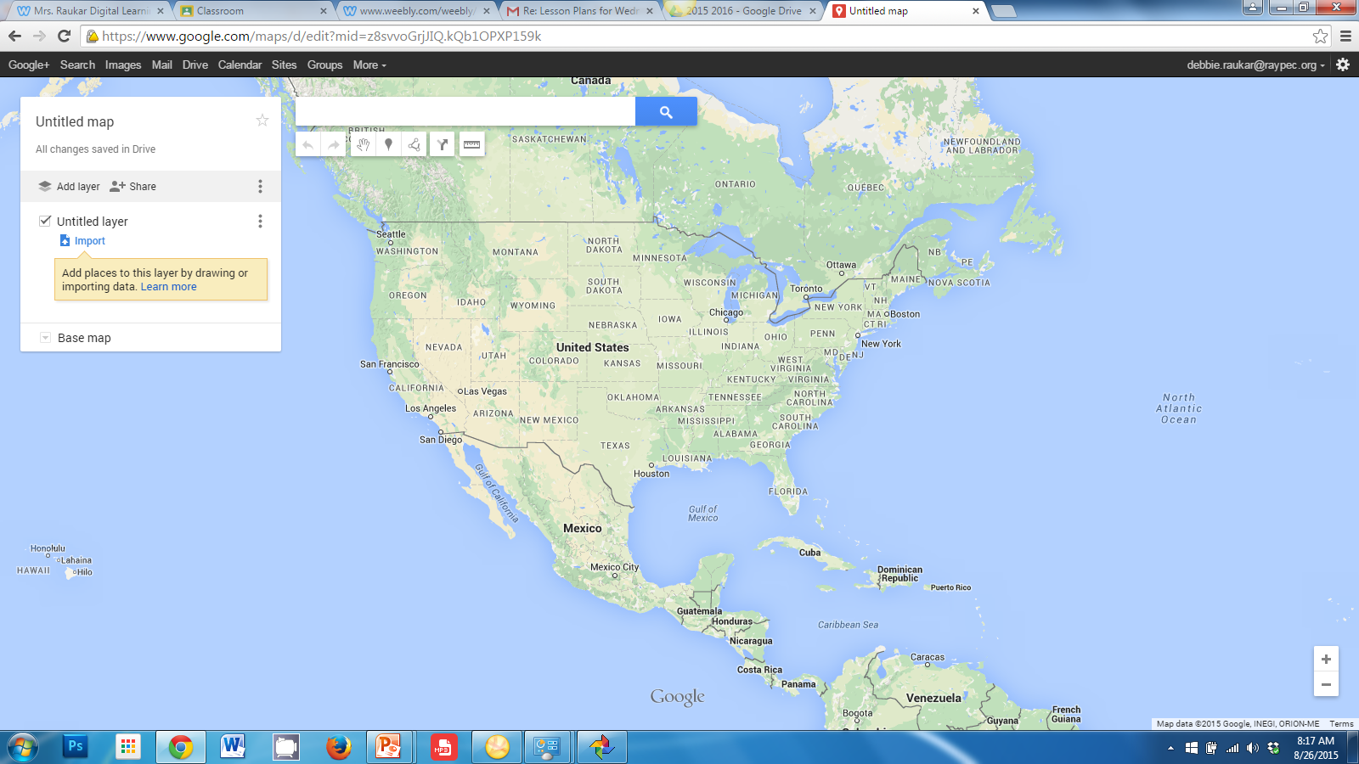

Slide 4
Click ADD DIRECTIONS

Slide 5
Go to Untitled Layer at
bottom.
See Driving.
Type Eagle Glen Intermediate
You will see the address
pop up
Click it.

Slide 6
Go to Untitled Layer at bottom.
See Driving.
In B, type your address.
Start with your street address
(i.e. 428 W Foxwood Dr.
Raymore, MO)
Click UNTITLED Layer to name it
Name it Directions to School
Save and/OR ENTER

Slide 7
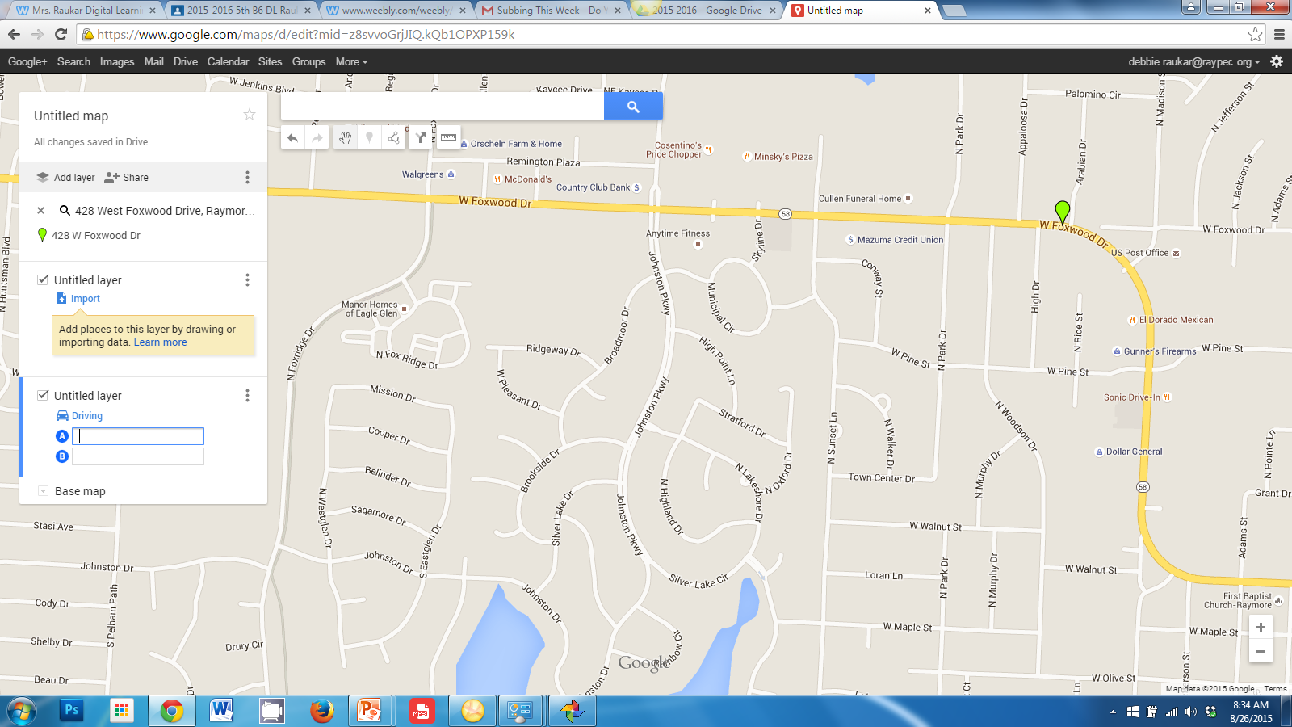
See Directions

Slide 8
Click the 3 dots
By Directions…
Click
Step-by-step
Directions

Slide 9
Find out
Who is closest
To school
Furthest from
School. Animal
cracker treats
for winners.

Slide 10
Explore time:
-Check out the other tools
and practice using them.
-Try another direction
-Use share button to share
w/another student.
-Zoom in and out
-Google Street view & type
your address

