Slide 1
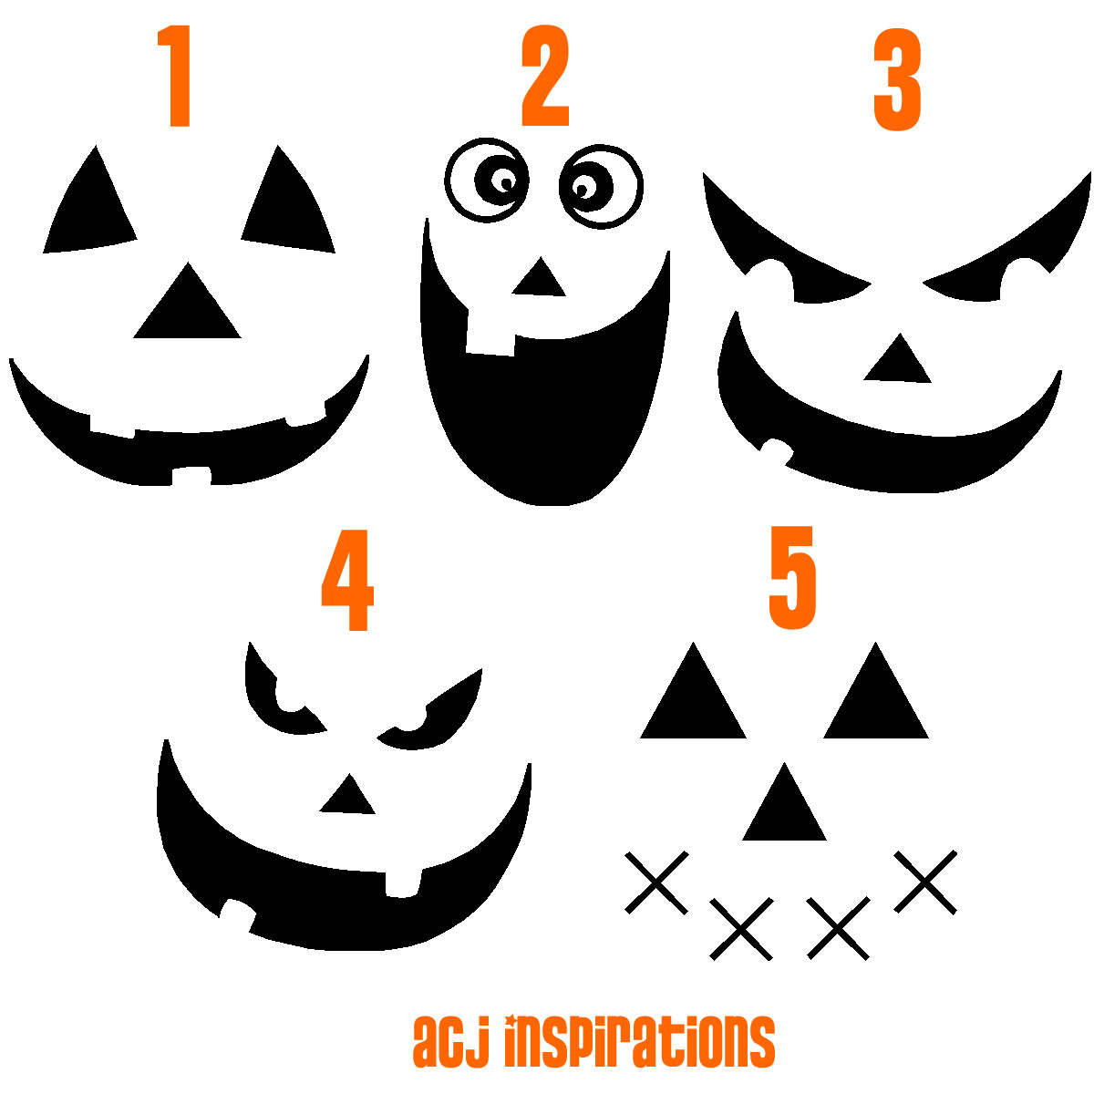
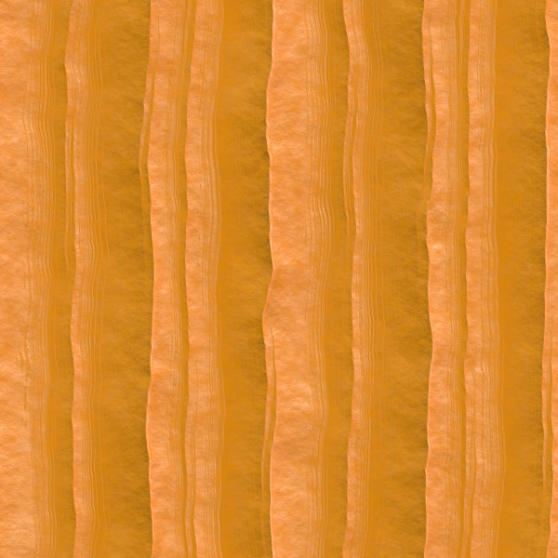

Notes:
Use the curve tool to draw your own pumpkin face. INSERT…SHAPES…LINES (click the line that is titled CURVE). Click each time you want to “bend the line”. Point A must match Point B to be able to fill it in.

Slide 3
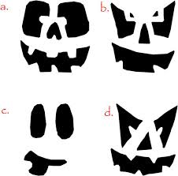

Slide 4





